Slide 1
UNIT 3 LINKED LIST

Slide 2
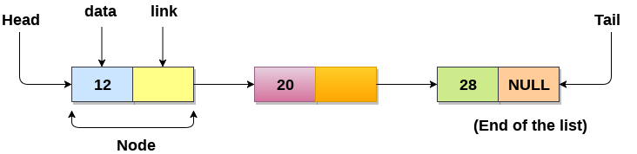
Linked List
Linked List can be defined as collection of objects called nodes that are randomly stored in the memory.
A node contains two fields i.e. data stored at that particular address and the pointer which contains the address of the next node in the memory.
The last node of the list contains pointer to the null.
Uses of Linked List
The list is not required to be contiguously present in the memory. The node can reside any where in the memory and linked together to make a list. This achieves optimized utilization of space.
list size is limited to the memory size and doesn't need to be declared in advance.
Empty node can not be present in the linked list.
We can store values of primitive types or objects in the singly linked list.

Slide 3
Node Creation :
struct node
{
int data;
struct node *next;
};
struct node *head, *ptr;
ptr = (struct node *)malloc(sizeof(struct node *));
Insertion in Linked list
SN | Operation | Description
1 | Insertion at beginning | It involves inserting any element at the front of the list. We just need to a few link adjustments to make the new node as the head of the list.
2 | Insertion at end of the list | It involves insertion at the last of the linked list. The new node can be inserted as the only node in the list or it can be inserted as the last one. Different logics are implemented in each scenario.
3 | Insertion after specified node | It involves insertion after the specified node of the linked list. We need to skip the desired number of nodes in order to reach the node after which the new node will be inserted. .

Slide 4
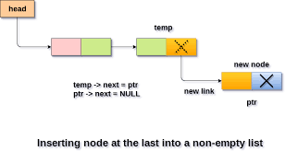
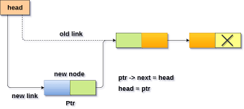
Insertion at the Beginning
struct node *ptr;
int item;
ptr = (struct node *) malloc(sizeof(struct node *));
if(ptr == NULL)
{
printf("\nOVERFLOW");
}
else
{
printf("\nEnter value\n");
scanf("%d",&item);
ptr->data = item;
ptr->next = head;
head = ptr;
printf("\nNode inserted");
}
Insertion At Last
struct node *ptr,*temp;
int item;
ptr = (struct node*)malloc(sizeof(struct node));
if(ptr == NULL)
{
printf("\nOVERFLOW");
}
else
{
printf("\nEnter value?\n");
scanf("%d",&item);
ptr->data = item;
if(head == NULL)
{
ptr -> next = NULL;
head = ptr;
printf("\nNode inserted");
}
else
{
temp = head;
while (temp -> next != NULL)
{
temp = temp -> next;
}
temp->next = ptr;
ptr->next = NULL;
printf("\nNode inserted");
}
}
}

Slide 5
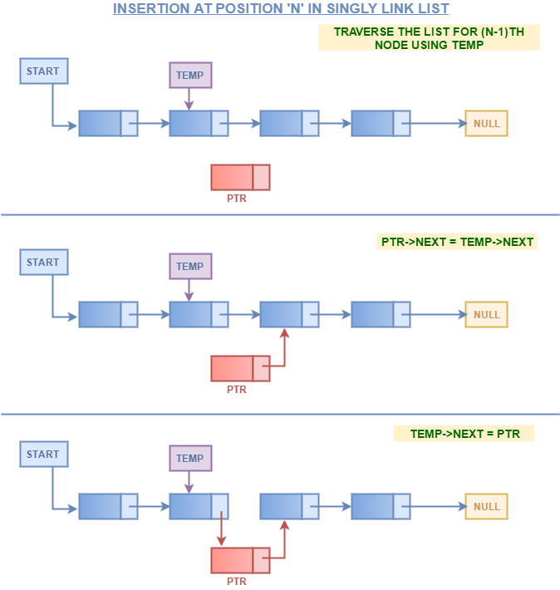
Random Insert at Position
int i,loc,item;
struct node *ptr, *temp;
ptr = (struct node *) malloc (sizeof(struct node));
if(ptr == NULL)
{
printf("\nOVERFLOW");
}
else
{
printf("\nEnter element value");
scanf("%d",&item);
ptr->data = item;
printf("\nEnter the location after which you want to insert ");
scanf("\n%d",&loc);
temp=head;
for(i=0;i<loc;i++)
{
temp = temp->next;
if(temp == NULL)
{
printf("\ncan't insert\n");
return;
}
}
ptr ->next = temp ->next;
temp ->next = ptr;
printf("\nNode inserted");
}

Slide 6
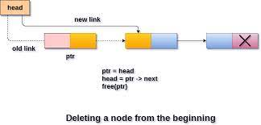
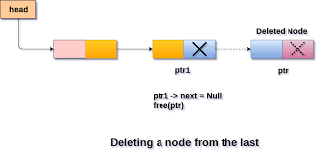
Begin Delete
struct node *ptr;
if(head == NULL)
{
printf("\nList is empty\n");
}
else
{
ptr = head;
head = ptr->next;
free(ptr);
printf("\nNode deleted from the begining ...\n");
}
Delete Last node
struct node *ptr,*ptr1;
if(head == NULL)
{
printf("\nlist is empty");
}
else if(head -> next == NULL)
{
head = NULL;
free(head);
printf("\nOnly node of the list deleted ...\n");
}
else
{
ptr = head;
while(ptr->next != NULL)
{
ptr1 = ptr;
ptr = ptr ->next;
}
ptr1->next = NULL;
free(ptr);
printf("\nDeleted Node from the last ...\n");
}

Slide 7
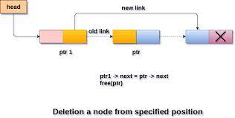
Random Delete node at Position
struct node *ptr,*ptr1;
int loc,i;
printf("\n Enter the location of the node after which you want to perform deletion \n");
scanf("%d",&loc);
ptr=head;
for(i=0;i<loc;i++)
{
ptr1 = ptr;
ptr = ptr->next;
if(ptr == NULL)
{
printf("\nCan't delete");
return;
}
}
ptr1 ->next = ptr ->next;
free(ptr);
printf("\nDeleted node %d ",loc+1);

Slide 8
Find node in Linked List
struct node *ptr;
int item,i=0,flag;
ptr = head;
if(ptr == NULL)
{
printf("\nEmpty List\n");
}
else
{
printf("\nEnter item which you want to search?\n");
scanf("%d",&item);
while (ptr!=NULL)
{
if(ptr->data == item)
{
printf("item found at location %d ",i+1);
flag=0;
}
else
{
flag=1;
}
i++;
ptr = ptr -> next;
}
if(flag==1)
{
printf("Item not found\n");
}
}

Slide 9
Display Linked List
struct node *ptr;
ptr = head;
if(ptr == NULL)
{
printf("Nothing to print");
}
else
{
printf("\nprinting values . . . . .\n");
while (ptr!=NULL)
{
printf("\n%d",ptr->data);
ptr = ptr -> next;
}
}

Slide 10
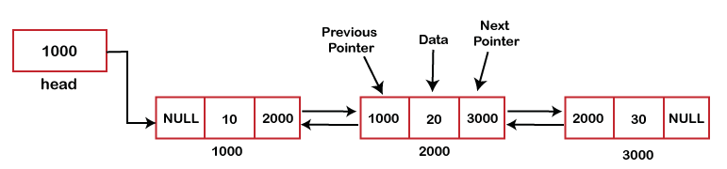
Doubly linked list
What is a doubly-linked list?
A doubly linked list is another type of the linked list. It is called a doubly linked list because it contains two addresses while a singly linked list contains a single address. It is a list that has total three parts, one is a data part, and others two are the pointers, i.e., previous and next. The previous pointer holds the address of the previous node, and the next pointer holds the address of the next node. Therefore, we can say that list has two references, i.e., forward and backward reference to traverse in either direction.
In c the structure of a node is describe as :
struct node
{
struct node *prev;
int data;
struct node *next;
}

Slide 11
Memory Representation of a doubly linked list
Memory Representation of a doubly linked list is shown in the following image. Generally, doubly linked list consumes more space for every node and therefore, causes more expansive basic operations such as insertion and deletion. However, we can easily manipulate the elements of the list since the list maintains pointers in both the directions (forward and backward).
In the following image, the first element of the list that is i.e. 13 stored at address 1. The head pointer points to the starting address 1. Since this is the first element being added to the list therefore the prev of the list contains null. The next node of the list resides at address 4 therefore the first node contains 4 in its next pointer.
We can traverse the list in this way until we find any node containing null or -1 in its next part.

Slide 12
Insert at Begining
struct node *ptr;
int item;
ptr = (struct node *)malloc(sizeof(struct node));
if(ptr == NULL)
{
printf("\nOVERFLOW");
}
else
{
printf("\nEnter Item value");
scanf("%d",&item);
if(head==NULL)
{
ptr->next = NULL;
ptr->prev=NULL;
ptr->data=item;
head=ptr;
}
else
{
ptr->data=item;
ptr->prev=NULL;
ptr->next = head;
head->prev=ptr;
head=ptr;
}
printf("\nNode inserted\n");
}
Insert at Last
struct node *ptr,*temp;
int item;
ptr = (struct node *) malloc(sizeof(struct node));
if(ptr == NULL)
{
printf("\nOVERFLOW");
}
else
{
printf("\nEnter value");
scanf("%d",&item);
ptr->data=item;
if(head == NULL)
{
ptr->next = NULL;
ptr->prev = NULL;
head = ptr;
}
else
{
temp = head;
while(temp->next!=NULL)
{
temp = temp->next;
}
temp->next = ptr;
ptr ->prev=temp;
ptr->next = NULL;
}
}
printf("\nnode inserted\n");

Slide 13
Insert at Position
struct node *ptr,*temp;
int item,loc,i;
ptr = (struct node *)malloc(sizeof(struct node));
if(ptr == NULL)
{
printf("\n OVERFLOW");
}
else
{
temp=head;
printf("Enter the location");
scanf("%d",&loc);
for(i=0;i<loc;i++)
{
temp = temp->next;
if(temp == NULL)
{
printf("\n There are less than %d elements", loc);
return;
}
}
printf("Enter value");
scanf("%d",&item);
ptr->data = item;
ptr->next = temp->next;
ptr -> prev = temp;
temp->next = ptr;
temp->next->prev=ptr;
printf("\nnode inserted\n");
}
Deletion at Begining
struct node *ptr;
if(head == NULL)
{
printf("\n UNDERFLOW");
}
else if(head->next == NULL)
{
head = NULL;
free(head);
printf("\nnode deleted\n");
}
else
{
ptr = head;
head = head -> next;
head -> prev = NULL;
free(ptr);
printf("\nnode deleted\n");
}

Slide 14
Deletion at last
struct node *ptr;
if(head == NULL)
{
printf("\n UNDERFLOW");
}
else if(head->next == NULL)
{
head = NULL;
free(head);
printf("\nnode deleted\n");
}
else
{
ptr = head;
if(ptr->next != NULL)
{
ptr = ptr -> next;
}
ptr -> prev -> next = NULL;
free(ptr);
printf("\nnode deleted\n");
}
Deletion at Position
struct node *ptr, *temp;
int val;
printf("\n Enter the data after which the node is to be deleted : ");
scanf("%d", &val);
ptr = head;
while(ptr -> data != val)
ptr = ptr -> next;
if(ptr -> next == NULL)
{
printf("\nCan't delete\n");
}
else if(ptr -> next -> next == NULL)
{
ptr ->next = NULL;
}
else
{
temp = ptr -> next;
ptr -> next = temp -> next;
temp -> next -> prev = ptr;
free(temp);
printf("\nnode deleted\n");
}

Slide 15
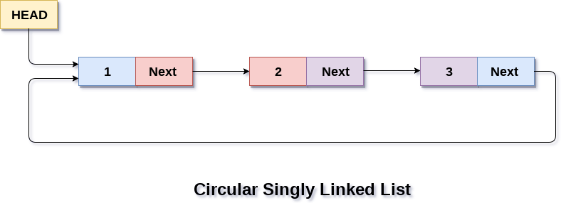
Circular linked list
In a circular Singly linked list, the last node of the list contains a pointer to the first node of the list. We can have circular singly linked list as well as circular doubly linked list.
We traverse a circular singly linked list until we reach the same node where we started. The circular singly liked list has no beginning and no ending. There is no null value present in the next part of any of the nodes.
The following image shows a circular singly linked list.

Slide 16
Begin Insert
struct node *ptr,*temp;
int item;
ptr = (struct node *)malloc(sizeof(struct node));
if(ptr == NULL)
{
printf("\nOVERFLOW");
}
else
{
printf("\nEnter the node data?");
scanf("%d",&item);
ptr -> data = item;
if(head == NULL)
{
head = ptr;
ptr -> next = head;
}
else
{
temp = head;
while(temp->next != head)
temp = temp->next;
ptr->next = head;
temp -> next = ptr;
head = ptr;
}
printf("\nnode inserted\n");
}
Last Insert
struct node *ptr,*temp;
int item;
ptr = (struct node *)malloc(sizeof(struct node));
if(ptr == NULL)
{
printf("\nOVERFLOW\n");
}
else
{
printf("\nEnter Data?");
scanf("%d",&item);
ptr->data = item;
if(head == NULL)
{
head = ptr;
ptr -> next = head;
}
else
{
temp = head;
while(temp -> next != head)
{
temp = temp -> next;
}
temp -> next = ptr;
ptr -> next = head;
}
printf("\nnode inserted\n");
}

Slide 17
Begin Delete
struct node *ptr;
if(head == NULL)
{
printf("\nUNDERFLOW");
}
else if(head->next == head)
{
head = NULL;
free(head);
printf("\nnode deleted\n");
}
else
{ ptr = head;
while(ptr -> next != head)
ptr = ptr -> next;
ptr->next = head->next;
free(head);
head = ptr->next;
printf("\nnode deleted\n");
}
Last Delete
struct node *ptr, *preptr;
if(head==NULL)
{
printf("\nUNDERFLOW");
}
else if (head ->next == head)
{
head = NULL;
free(head);
printf("\nnode deleted\n");
}
else
{
ptr = head;
while(ptr ->next != head)
{
preptr=ptr;
ptr = ptr->next;
}
preptr->next = ptr -> next;
free(ptr);
printf("\nnode deleted\n");
}

Slide 18
Search node
struct node *ptr;
int item,i=0,flag=1;
ptr = head;
if(ptr == NULL)
{
printf("\nEmpty List\n");
}
else
{
printf("\nEnter item which you want to search?\n");
scanf("%d",&item);
if(head ->data == item)
{
printf("item found at location %d",i+1);
flag=0;
}
else
{
while (ptr->next != head)
{
if(ptr->data == item)
{
printf("item found at location %d ",i+1);
flag=0;
break;
}
else
{
flag=1;
}
i++;
ptr = ptr -> next;
}
}
if(flag != 0)
{
printf("Item not found\n");
}
}

Slide 19
Display linked list
struct node *ptr;
ptr=head;
if(head == NULL)
{
printf("\nnothing to print");
}
else
{
printf("\n printing values ... \n");
while(ptr -> next != head)
{
printf("%d\n", ptr -> data);
ptr = ptr -> next;
}
printf("%d\n", ptr -> data);
}

Slide 20
Dynamic memory allocation in C
The concept of dynamic memory allocation in c language enables the C programmer to allocate memory at runtime. Dynamic memory allocation in c language is possible by 4 functions of stdlib.h header file.
malloc()
calloc()
realloc()
free()
Before learning above functions, let's understand the difference between static memory allocation and dynamic memory allocation.

Slide 21
static memory allocation | dynamic memory allocation
memory is allocated at compile time. | memory is allocated at run time.
memory can't be increased while executing program. | memory can be increased while executing program.
used in array. | used in linked list.
malloc() | allocates single block of requested memory.
calloc() | allocates multiple block of requested memory.
realloc() | reallocates the memory occupied by malloc() or calloc() functions.
free() | frees the dynamically allocated memory.

Slide 22
malloc
The malloc() function allocates single block of requested memory.
It doesn't initialize memory at execution time, so it has garbage value initially.
It returns NULL if memory is not sufficient.
The syntax of malloc() function is given below:
ptr=(cast-type*)malloc(byte-size)
Eg.
printf("Enter number of elements: ");
scanf("%d",&n);
ptr=(int*)malloc(n*sizeof(int)); //memory allocated using malloc
Calloc
The calloc() function allocates multiple block of requested memory.
It initially initialize all bytes to zero.
It returns NULL if memory is not sufficient.
syntax : ptr=(cast-type*)calloc(number, byte-size)
Eg.
printf("Enter number of elements: ");
scanf("%d",&n);
ptr=(int*)calloc(n,sizeof(int)); //memory allocated using calloc

